Slide 1



2020
概率论答疑：第2章 1-4节
徐置成 信管

Slide 2
01
Random Variables
PART 01

Slide 3
Random variable
Definition
Let S be the sample space for an experiment. If for any ω∈S, there exists a unique real number X(ω)∈ℝ, then the real-valued function X is called a random variable．
Remark 2.1.1
Random variables are usually denoted by capital letters X, Y, Z, ··· or little greek letters ξ, η, ζ, ···．
The range of the values are known but the specific value cannot be predicted with certainty before the experiment is run．

Slide 4
Random variable
Example 2.1.1 A die is rolled. The sample space is S＝{１,２,３,４,５,６}．Let X＝１if the outcome is even and X＝０if the outcome is odd. Let Y＝１ if the outcome is six and Y＝０otherwise. X and Y are two random variables defined on the same sample space.
Example 2.1.2 Measure the lifetime of a light bulb. The lifetime is a random variable. It can take all nonnegative values.

Slide 5
Random variable
随机变量
离散型随机变量(Discrete random variable)：掷骰子
连续型随机变量(Continuous random variable)：灯的寿命

Slide 6
Cumulative
Distribution
Function
02
PART 02

Slide 7
Cumulative Distribution Function
Random variable X is a real-valued function of sample point ω. If A is a subset of real numbers, then X∈A represents the following random event
{ω|X(ω)∈A}.
Specially, {X ≤ a}, {X＞a}and {a＜X＜b} are events. We are interested in the collection of all probabilities of the form P(X∈A). Since
{a＜X ≤ b}＝{X ≤ b}－{X ≤ a},
{X＞a}＝S－{X ≤ a}．
It is sufficient to know the probability of {X ≤ x} for any real number x.

Slide 8
Cumulative Distribution Function
Definition
The distribution function or cumulative distribution function (abbreviated as CDF) F(x) of a random variable X is the function
F(x)＝P(X ≤ x),－∞＜x＜＋∞．
If X is thought as a random point on the real line, then F(x) is the probability that X falls into the interval (－∞,x].
The cumulative distribution function is defined as above for every random variable X, regardless of whether X is discrete, continuous or mixed．

Slide 9

Cumulative Distribution Function
Property（充分必要条件）
x_{１}＜x_{２}, F(x_{１})≤F(x_{２})
2. For any real number x, ０≤F(x)≤１
$\lim_{x→−∞}{F\left(x\right)=0} \lim_{x→+∞}{F\left(x\right)=1}$
3. $F\left({x_{0}}^{+}\right)=F(x_{0})$

Slide 10
Cumulative Distribution Function
Proposition（命题）
For every real numbers a < b, the following formulas are valid:
P(X > a) = 1 − F(a)
P(a < X ≤ b) = F(b) − F(a)
P(X < a) = F(a⁻)
P(X = a) = F(a) − F(a⁻)

Slide 11
Cumulative Distribution Function
CDF 累积分布函数
[0，1] -∞是0，+∞是1
积分，非减，右连续

Slide 12
03
Discrete Distribution
PART 03

Slide 13
Discrete Distribution
Definition1
A random variable X has a discrete distribution or X is a discrete random variable if it can take only a finite number of different values x₁,··· ,x_{k} or, at most, an infinite sequence of different values x₁,x₂,···

Slide 14
Discrete Distribution
Definition2
If a random variable X has a discrete distribution, the probability function (abbreviated as PF) of X is defined as the function f(·) such that for every real number x,
f(x) = P(X = x) ≥ 0.
It can also be represented as the following：
The probability function of X fully reflects all the values X can take and their corresponding probabilities. The probability function has the following properties.

Slide 15
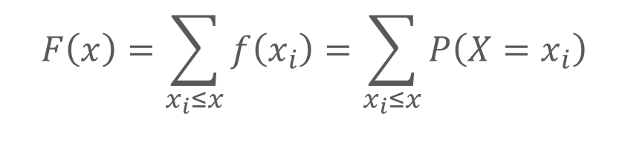
Discrete Distribution
Proposition
If X has a discrete distribution with the PF f(x), its CDF can be determined from the relation
$$F\left(x\right)=\sum_{x_{i}≤x}{f\left(x_{i}\right)}=\sum_{x_{i}≤x}{P\left(X=x_{i}\right)}$$
F(x) will have a jump of magnitude f(x_{i}) at each possible value x_{i} of X, and F(x) will be constant between every pair of successive jumps. F(x) and f(x) can be determined from each other.

Slide 16
04
Some Common
Discrete Distributions
PART 04

Slide 17
Bernoulli distribution
Definition
A random variable X that takes only two values 0 and 1 with P(X = 1) = p has the Bernoulli distribution with parameter 0 < p < 1
Bernoulli distribution is also called 0-1 distribution. We denote it as X ∼ B(1,p).

Slide 18
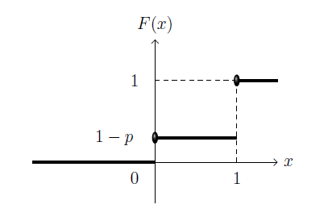
Bernoulli distribution

Slide 19
2.4 binomial distribution
Proposition 2.4.1
Suppose X ∼ B(n,p). The PF of X will be as follows:
The binomial distribution is the sum of n independent Bernoulli random variables with same parameter p.
) where X_{i} ∼B(1,p).
Note: not every sum of Bernoulli random variables has a binomial distribution. The Bernoulli random variables must be mutually independent, and they must all have the same parameter.

Slide 20
2.4 binomial distribution
The PF of X can be understood as follows: we want exactly x successes (p^{x}) and n−x failures (1−p)^{n−x}. Moreover, the x successes can occur anywhere among the n trials, and there are different ways of distributing x successes in a sequence of n trials.
If n = 1, Binomial distribution reduces to the Bernoulli distribution.

Slide 21
2.4 Some Common Discrete Distributions
Theorem 2.4.1
Suppose X ∼ B(n,p), if (n + 1)p is an integer, the most likely number of X is k₀ = (n + 1)p or (n + 1)p − 1; otherwise the most likely number of X is [(n+1)p], the greatest integer less than (n+1)p. The least likely number of X is 0 or n.

Slide 22
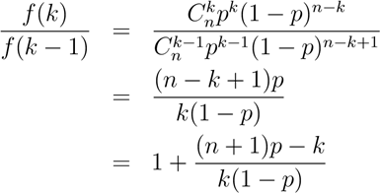
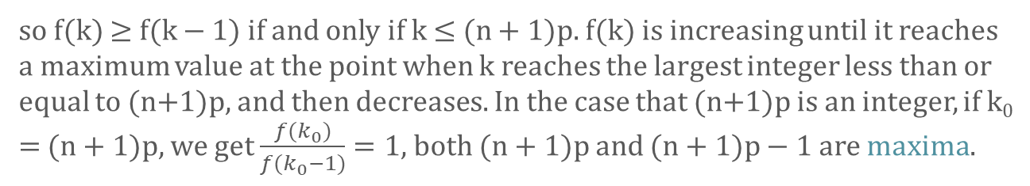
2.4 Some Common Discrete Distributions
Proof
Consider the ratio of two consecutive probabilities, for k = 1,2,··· ,n,
so f(k) ≥ f(k − 1) if and only if k ≤ (n + 1)p. f(k) is increasing until it reaches a maximum value at the point when k reaches the largest integer less than or equal to (n+1)p, and then decreases. In the case that (n+1)p is an integer, if k₀ = (n + 1)p, we get $\frac{f(k_{0})}{f(k_{0}−1)}=1$, both (n + 1)p and (n + 1)p − 1 are maxima.

Slide 23

2.4 Some Common Discrete Distributions
Definition 2.4.3
A random variable X has the Poisson distribution with parameter λ > 0, denoted as X ∼ P(λ) or Poisson(λ), if the probability function of X is as follows:
Many phenomena in the life and social sciences can be modeled using the Poisson distribution. It is useful in counting the number of occurrences in a given unit of measurement. Examples include arrivals of customers entering a bank on a given day, arrivals of calls at a switchboard in a day, the number of misprints per page of a book, and so forth.
In addition, Poisson distribution is a limiting case of a Binomial distribution when the number of trials gets very large and the probability of success is small.

Slide 24


2.4 Some Common Discrete Distributions
Theorem 2.4.2
For each n ≥ 1, Let X_{n} ∼ B (n,p_{n}), If $\lim_{n→∞}{np_{n}=λ}$, then X can be approximated by X ∼ Poisson(λ). That is, for k ≥ 0,

